Slide 1

Introduction to WebAnno
Dr. Joshua Waxman
Stern College for Women, YU

Slide 2
Outline
What is Named Entity Recognition?
Walkthrough of built-in WebAnno Demo for Named Entities
What is Relation Extraction?
Walkthrough of built-in WebAnno Demo for Relations
A look at the export file format
From scratch, Create Project, Layers, Tagset, Exporting
Reading in the exported file, using for ML

Slide 3
Named Entities

Slide 4
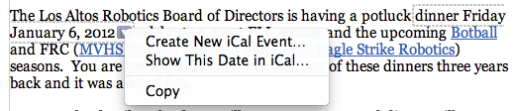
Information Extraction
Information Extraction = extract clear, factual information; find important parts of text, assemble, produce structured representation of information
* Credit to Jurafsky and Manning Slides

Slide 5
Named Entity Recognition (NER)
Important subtask – find and classify names in text, for example:
The decision by the independent MP Andrew Wilkie to withdraw his support for the minority Labor government sounded dramatic but it should not further threaten its stability. When, after the 2010 election, Wilkie, Rob Oakeshott, Tony Windsor and the Greens agreed to support Labor, they gave just two guarantees: confidence and supply.

Slide 6
Named Entity Recognition (NER)
Important subtask – find and classify names in text, for example:
The decision by the independent MP Andrew Wilkie to withdraw his support for the minority Labor government sounded dramatic but it should not further threaten its stability. When, after the 2010 election, Wilkie, Rob Oakeshott, Tony Windsor and the Greens agreed to support Labor, they gave just two guarantees: confidence and supply.

Slide 7
Named Entity Recognition (NER)
Important subtask: find and classify names in text, for example:
The decision by the independent MP Andrew Wilkie to withdraw his support for the minority Labor government sounded dramatic but it should not further threaten its stability. When, after the 2010 election, Wilkie, Rob Oakeshott, Tony Windsor and the Greens agreed to support Labor, they gave just two guarantees: confidence and supply.
Person
Date
Location
Organization
Notes:
Say how this is often a very large part of IE – knowing entity types takes you a long way in IE. Biomedical example.
so let's talk a bit more about NER and how it's evaluated, and then we'll talk about two approaches for doing it
so I already defined NER. you have a piece of text, and you want to:
1. find things that are names: European Commission, John Lloyd Jones, etc.
2. give them labels: ORG, PERS, etc.
note that in this particular example "Thursday" was not labeled

Slide 8
Named Entity Recognition (NER)
The uses:
Named entities can be indexed, linked off, etc.
Sentiment can be attributed to companies or products
A lot of IE relations are associations between named entities
For question answering, answers are often named entities.
Concretely:
Many web pages tag various entities, with links to bio or topic pages, etc.
Reuters’ OpenCalais, Evri, AlchemyAPI, Yahoo’s Term Extraction, …
Apple/Google/Microsoft/… smart recognizers for document content
Notes:
First, let's define NER!
go through pages, recognize the names of things: "Bill MacCartney", "Stanford University"
the people who came up with this task had a rather precise, philosophically motivated meaning in mind
entity: a discrete, actual thing: Bill MacCartney, but not calcium carbonate or Tuesday or Viagra
named entity: an entity with a name, in a philosophical, Kripke-like sense
(this water bottle is an entity, but not a NAMED entity)
but in practice the definition has been expanded quite a bit in later work
we routinely include dates & times, proteins, drug names
but still, loosely, things that have a name
but NOT references to entities which are not names: "this university", "it”
first task in NER: identifying occurrences of named entities
looking for capital letters is a really good clue! at least in English! but not so much in Hebrew, Chinese, ... non-Latinate alphabets also doesn't really work in German -- all nouns are capitalized!
so that's a pretty useful base-level task -- widely deployed and used
you've probably seen web pages that do this
e.g. financial web sites often mark up stock symbols, names of companies
Microsoft has done work with this, smart tags, entities tagged with metadata
Reuters has web service OpenCalais, you send them docs, they send back NER markup

Slide 9
The Named Entity Recognition Task
Task: Predict entities in a text
Foreign ORG
Ministry ORG
spokesman O
Shen PER
Guofang PER
told O
Reuters ORG
: :
Standard evaluation
is per entity, not per token
}
Notes:
one way to think of task: sequence labeling, label each token with ORG/PER/.../O
one way you could eval is per-token, but that's not satisfactory
any user wants complete entity names
also, it's possible (though rare) to have adjacent entities "showed Sue Bill 's book"
standard eval is, you have subsequences of tokens and assess whether those are right
also, usually most tokens are O (other) -- this example not typical
so it doesn't seem like you should get points for getting O right
so we use the same eval metrics that are typical in IR: precision and recall

Slide 10
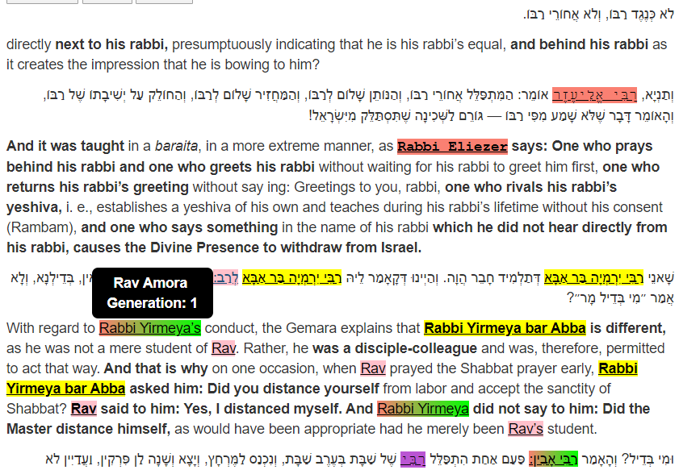
My own use of NER
http://www.mivami.org/talmud/Berakhot.27b

Slide 11
How do you do NER?
Manually
Expert crafts rules, regular expression
Machine Learning

Slide 12
The ML sequence model approach to NER
Training
Collect a set of representative training documents
Label each token for its entity class or other (O)
Design feature extractors appropriate to the text and classes
Train a sequence classifier to predict the labels from the data
Testing
Receive a set of testing documents
Run sequence model inference to label each token
Appropriately output the recognized entities

Slide 13
Encoding classes for sequence labeling
IO encoding IOB encoding
Fred PER B-PER
showed O O
Sue PER B-PER
Mengqiu PER B-PER
Huang PER I-PER
‘s O O
new O O
painting O O
Notes:
c classes: c + 1 labels vs. 2c + 1 labels. Stanford NER uses IO encoding
one way to think of task: sequence labeling, label each token with ORG/PER/.../O
one way you could eval is per-token, but that's not satisfactory
any user wants complete entity names
also, it's possible (though rare) to have adjacent entities "showed Sue Bill 's book"
standard eval is, you have subsequences of tokens and assess whether those are right
also, usually most tokens are O (other) -- this example not typical
so it doesn't seem like you should get points for getting O right
so we use the same eval metrics that are typical in IR: precision and recall

Slide 14
Features for sequence labeling
Words
Current word (essentially like a learned dictionary)
Previous/next word (context)
Other kinds of inferred linguistic classification
Part-of-speech tags
Label context
Previous (and perhaps next) label

Slide 15
WebAnno, Named Entities
To tag files, to correct machine-tagged files

Slide 16
Downloading / Starting WebAnno
https://webanno.github.io/webanno/downloads/
WebAnno 3.6.4 standalone (executable JAR)
Run it
WebAnno will create a directory called .webanno under your home directory and store its database and files there.
Then navigate to localhost:8080
Username: admin Password: Admin
(Of course, would want to host it, add additional users)

Slide 17
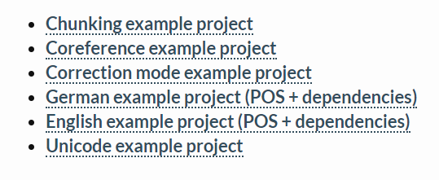
Downloading English Webanno project
https://webanno.github.io/webanno/downloads/
Do NOT unzip the zip file. It will be imported as a zip

Slide 18
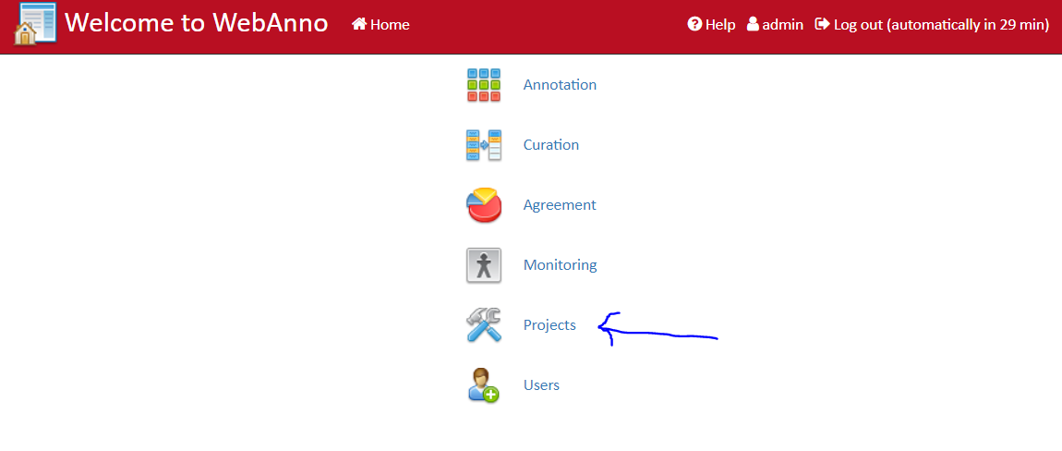
Step 1: Navigate to Projects

Slide 19
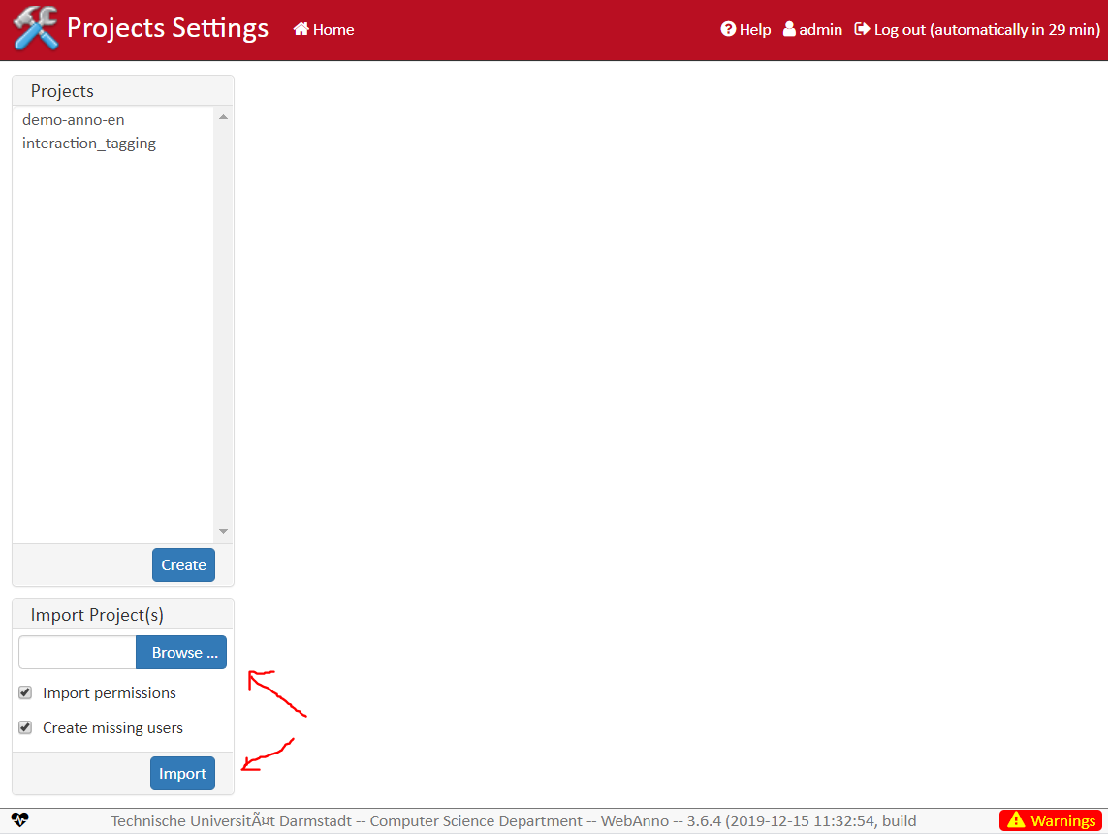
Step 2: Browse to zip file, then import

Slide 20
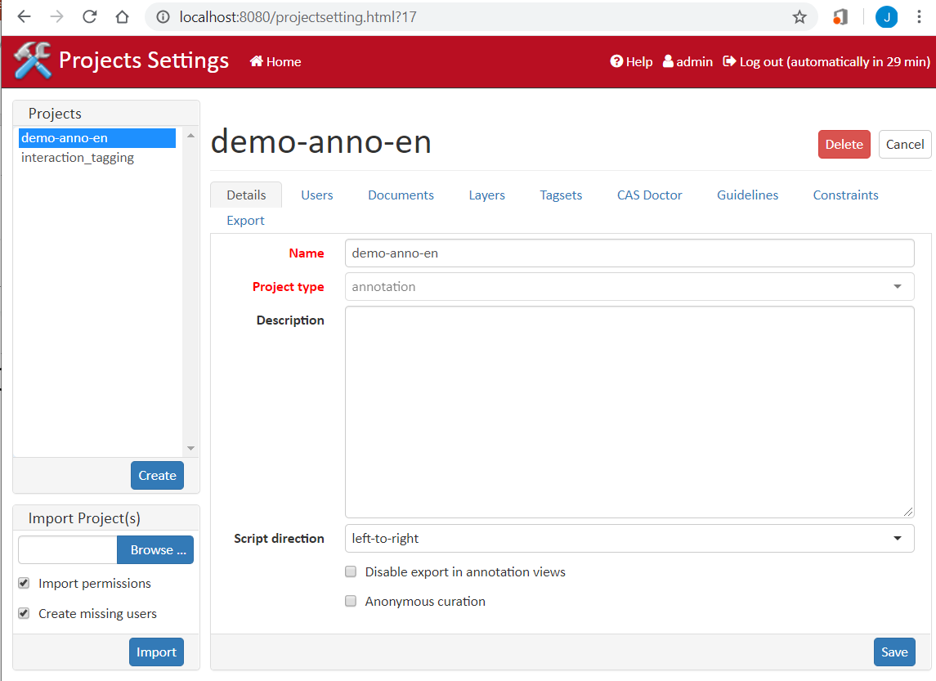
Step 3: Take a minute to explore project

Slide 21
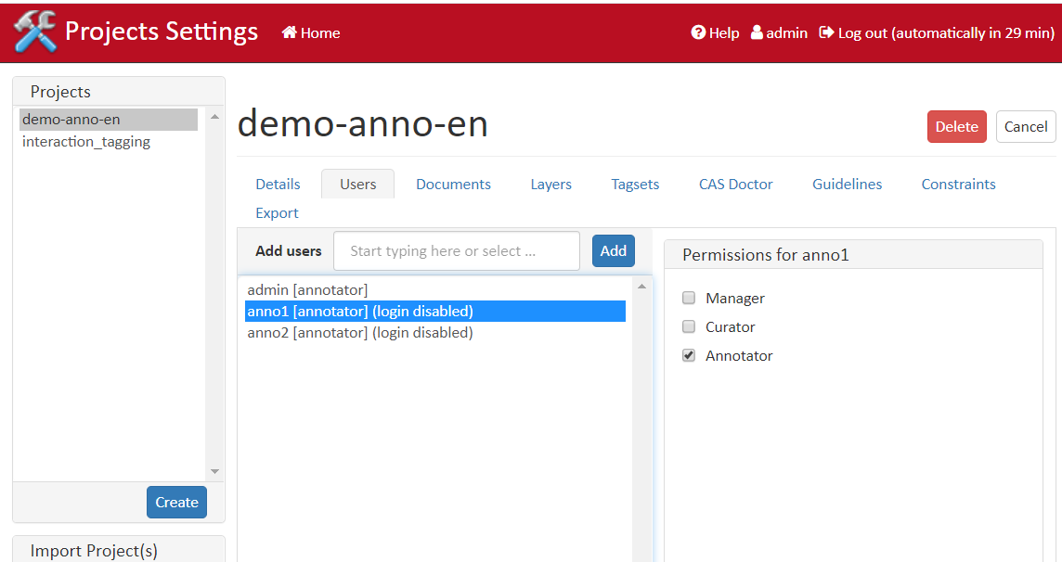
a. Users

Slide 22
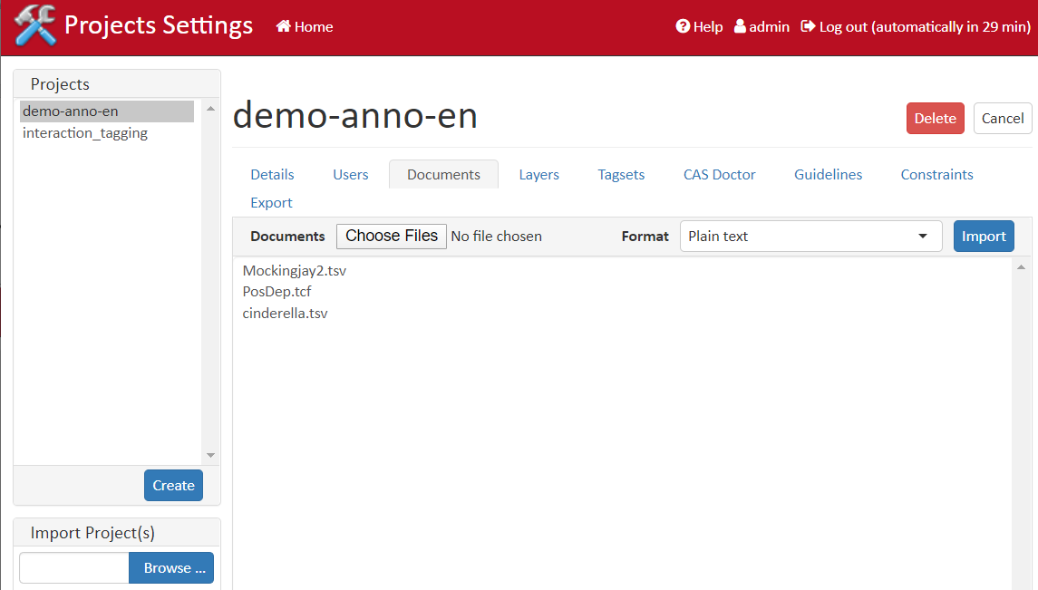
b. Documents

Slide 23
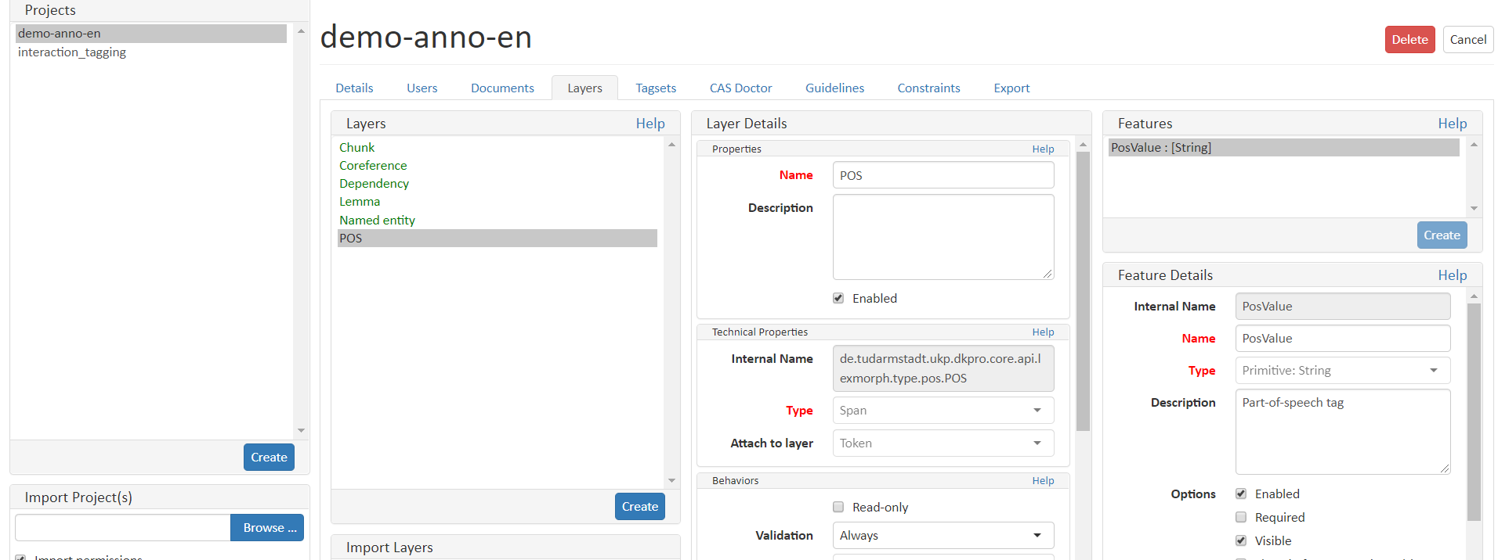
c. Layers (see POS, coref layer)

Slide 24
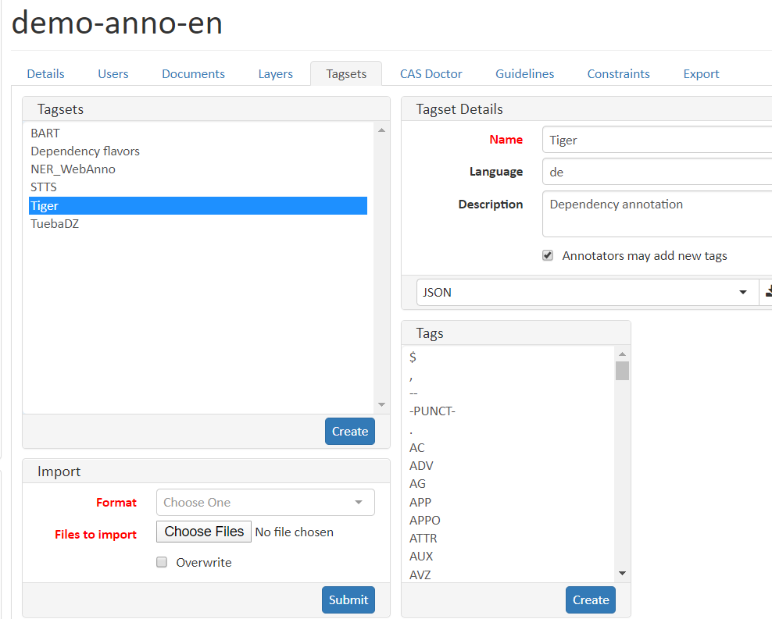
d. Tagsets

Slide 25
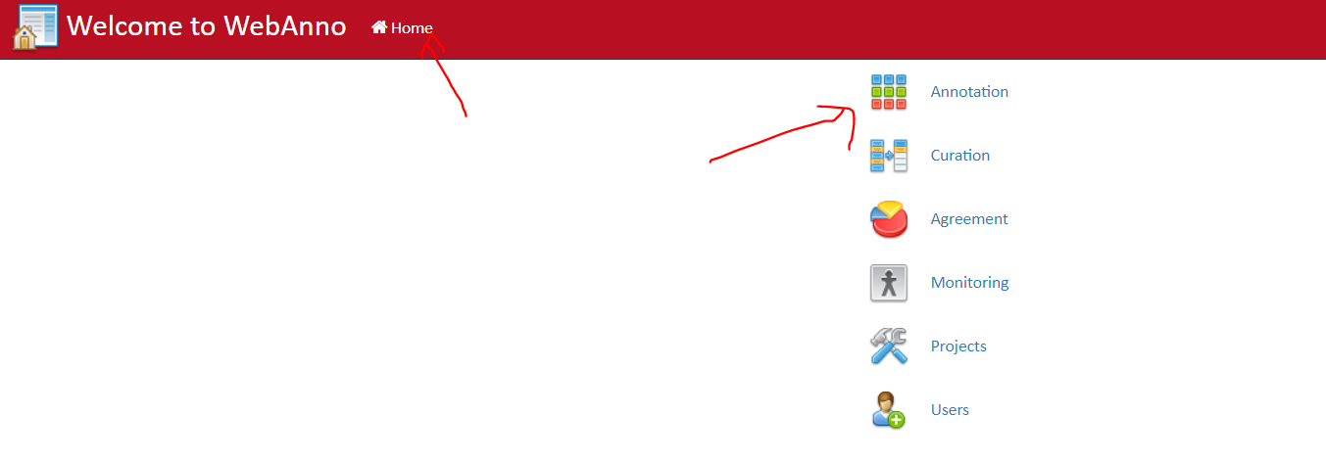
4. Navigate to Annotation Task

Slide 26
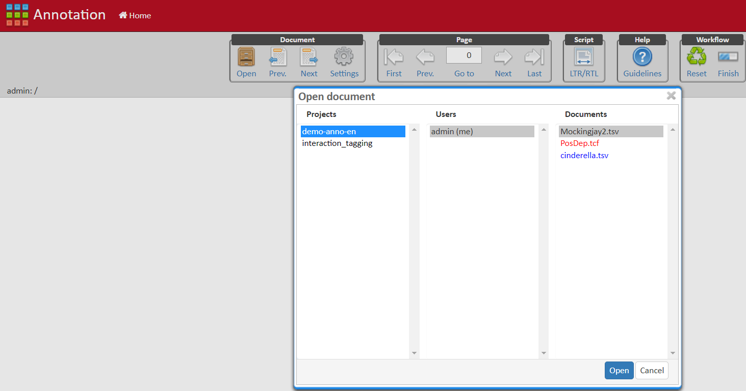
5. Open Mockingjay.tsv

Slide 27
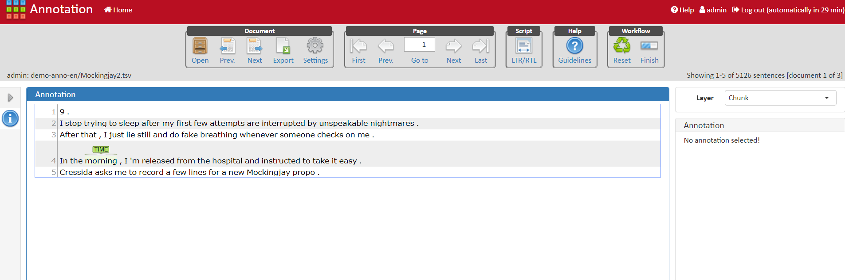
What does the document look like?
Tasks: 1) Hover over “morning”. What is it? What layer?
2) Change to that layer
3) Move to Prev and Next Page (not document)
4) Adjust settings, more rows, dynamic pastels

Slide 28
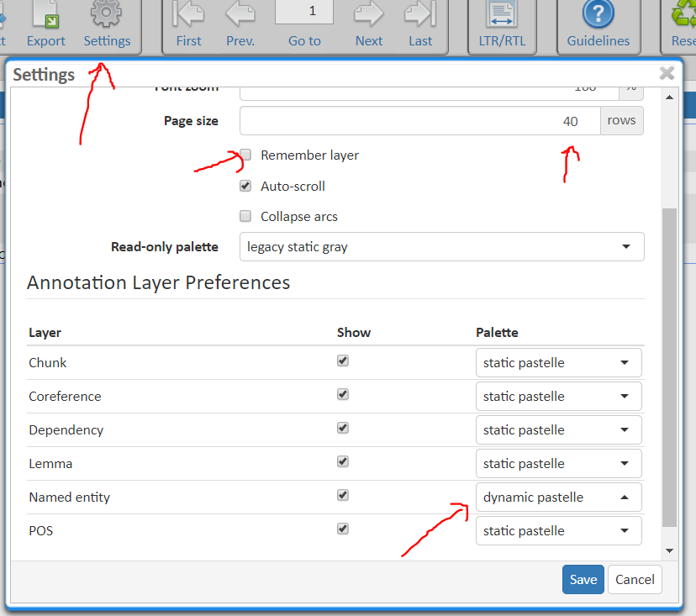
6. Adjust Settings
40 rows (not 5)
Remember layer
Named Entity layer should be dynamic pastelle. That way, different tag types will be different colors

Slide 29
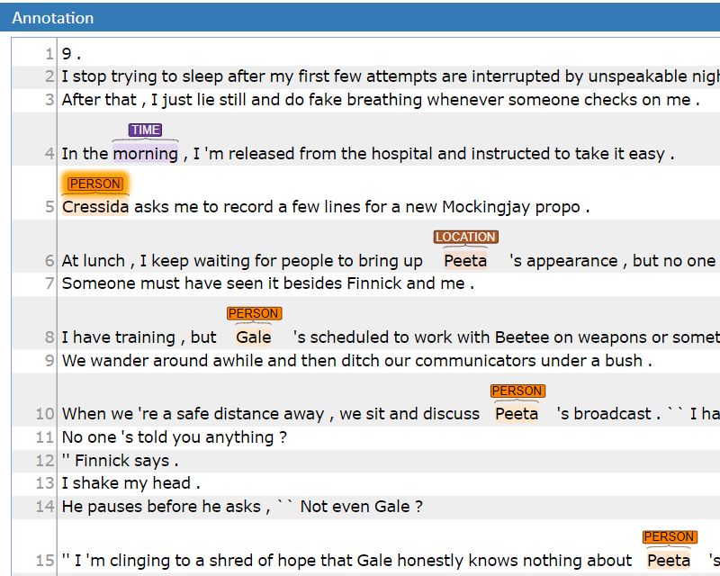
7. Apply some tags.
Tag Cressida as a PERSON
You can tag a span of words. (e.g. “waiting for people”)
Delete that Tag
Fix Peeta, who was marked as a LOCATION
Tag all PERSONs in document

Slide 30
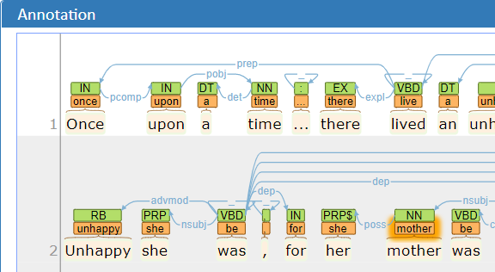
8. See multiple layers
Navigate to Cinderella
POS layer
Lemma layer
Relationships (dependencies) based on POS

Slide 31
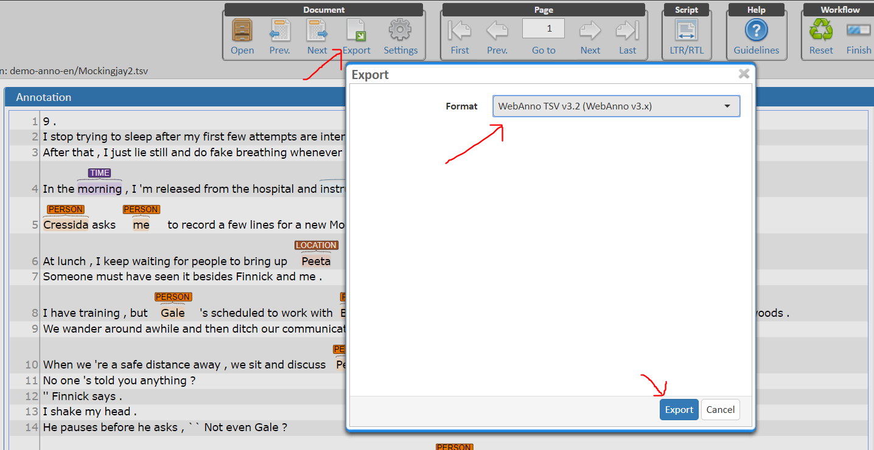
9. Export (Mockingjay as tsv file)

Slide 32
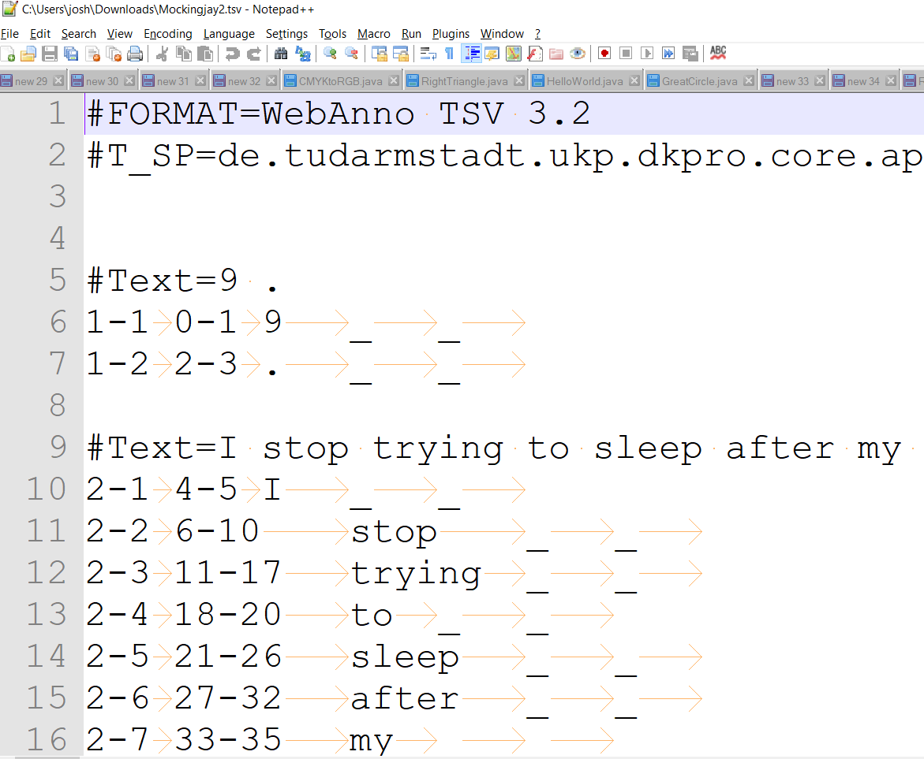
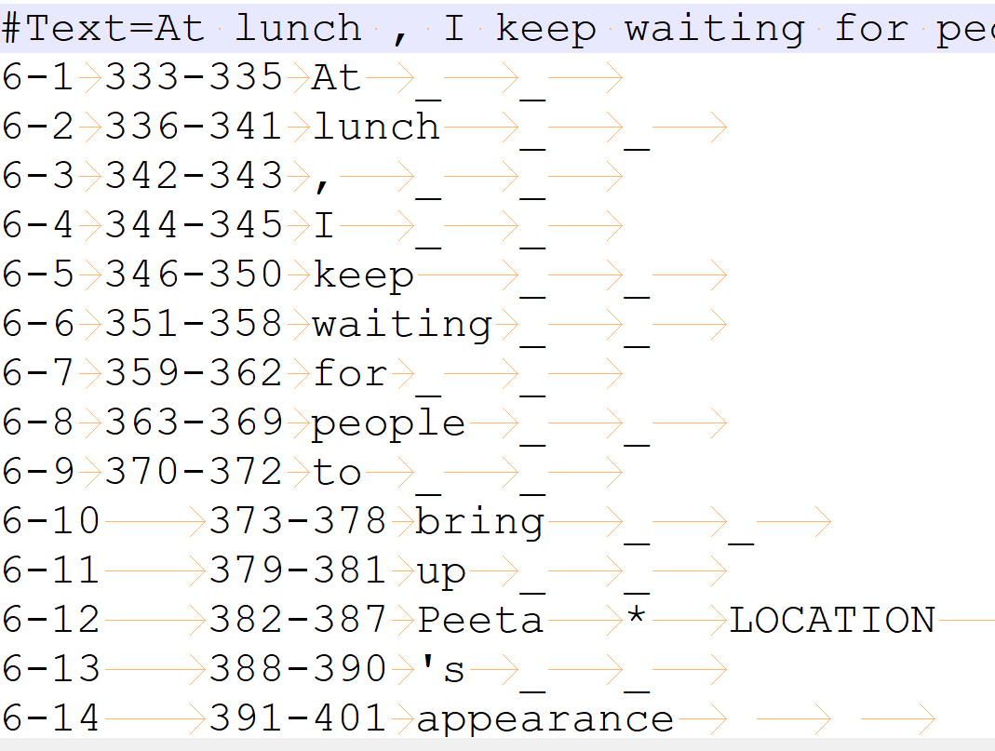
10. Examine file (using Notepad++)

Slide 33
Relation Extraction
(again adapted from Jurafsky and Manning lectures)

Slide 34
Extracting relations from text
Company report: “International Business Machines Corporation (IBM or the company) was incorporated in the State of New York on June 16, 1911, as the Computing-Tabulating-Recording Co. (C-T-R)…”
Extracted Complex Relation:
Company-Founding
Company IBM
Location New York
Date June 16, 1911
Original-Name Computing-Tabulating-Recording Co.
But we will focus on the simpler task of extracting relation triples
Founding-year(IBM,1911)
Founding-location(IBM,New York)

Slide 35
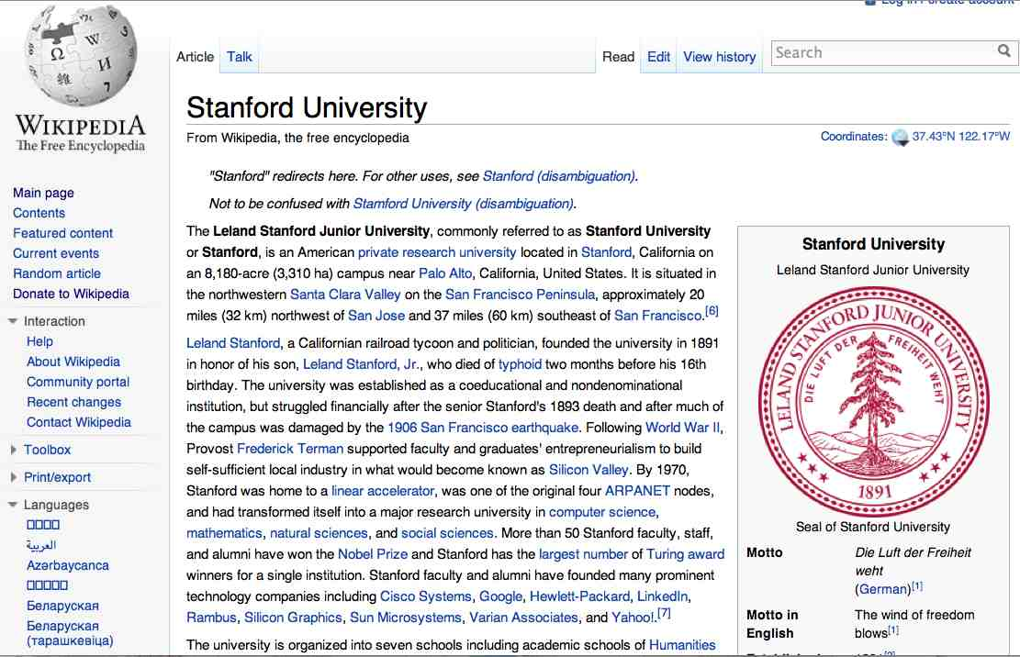
Extracting Relation Triples from Text
The Leland Stanford Junior University, commonly referred to as Stanford University or Stanford, is an American private research university located in Stanford, California … near Palo Alto, California… Leland Stanford…founded the university in 1891
Stanford EQ Leland Stanford Junior University
Stanford LOC-IN California
Stanford IS-A research university
Stanford LOC-NEAR Palo Alto
Stanford FOUNDED-IN 1891
Stanford FOUNDER Leland Stanford

Slide 36
Why Relation Extraction?
Create new structured knowledge bases, useful for any app
Augment current knowledge bases
Adding words to WordNet thesaurus, facts to FreeBase or DBPedia
Support question answering
The granddaughter of which actor starred in the movie “E.T.”?
(acted-in ?x “E.T.”)(is-a ?y actor)(granddaughter-of ?x ?y)

Slide 37
Automated Content Extraction (ACE)
17 relations from 2008 “Relation Extraction Task”

Slide 38
Automated Content Extraction (ACE)
Physical-Located PER-GPE
He was in Tennessee
Part-Whole-Subsidiary ORG-ORG
XYZ, the parent company of ABC
Person-Social-Family PER-PER
John’s wife Yoko
Org-AFF-Founder PER-ORG
Steve Jobs, co-founder of Apple…

Slide 39
UMLS: Unified Medical Language System
134 entity types, 54 relations
Injury disrupts Physiological Function
Bodily Location location-of Biologic Function
Anatomical Structure part-of Organism
Pharmacologic Substance causes Pathological Function
Pharmacologic Substance treats Pathologic Function

Slide 40
Ontological relations
Examples from the WordNet Thesaurus
IS-A (hypernym): subsumption between classes
Giraffe IS-A ruminant IS-A ungulate IS-A mammal IS-A vertebrate IS-A animal…
Instance-of: relation between individual and class
San Francisco instance-of city

Slide 41
How to build relation extractors
Hand-written patterns
Supervised machine learning
Semi-supervised and unsupervised
Bootstrapping (using seeds)
Distant supervision
Unsupervised learning from the web

Slide 42
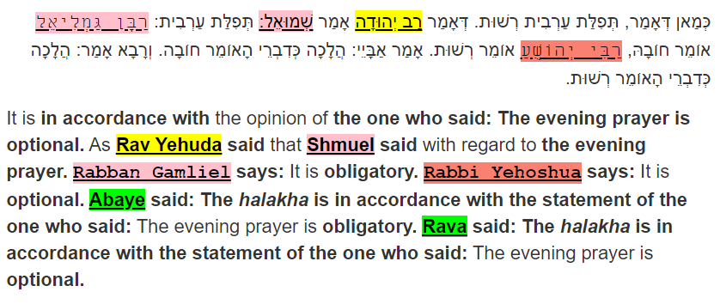
My own use of Relation Extraction

Slide 43
Supervised machine learning for relations
Choose a set of relations we’d like to extract
Choose a set of relevant named entities
Find and label data
Choose a representative corpus
Label the named entities in the corpus
Hand-label the relations between these entities
Break into training, development, and test
Train a classifier on the training set

Slide 44
How to do classification in supervised relation extraction
Find all pairs of named entities (usually in same sentence)
Decide if 2 entities are related
If yes, classify the relation
Why the extra step?
Faster classification training by eliminating most pairs
Can use distinct feature-sets appropriate for each task.

Slide 45

Relation Extraction
Classify the relation between two entities in a sentence
American Airlines, a unit of AMR, immediately matched the move, spokesman Tim Wagner said.
EMPLOYMENT
FAMILY
NIL
CITIZEN
…
INVENTOR
SUBSIDIARY
FOUNDER

Slide 46
Word Features for Relation Extraction
American Airlines, a unit of AMR, immediately matched the move, spokesman Tim Wagner said
Mention 1
Mention 2
Headwords of M1 and M2, and combination
Airlines Wagner Airlines-Wagner
Bag of words and bigrams in M1 and M2
{American, Airlines, Tim, Wagner, American Airlines, Tim Wagner}
Words or bigrams in particular positions left and right of M1/M2
M2: -1 spokesman
M2: +1 said
Bag of words or bigrams between the two entities
{a, AMR, of, immediately, matched, move, spokesman, the, unit}

Slide 47
WebAnno, Relationships
To tag files, to correct machine-tagged files

Slide 48
How to do classification in supervised relation extraction
Find all pairs of named entities (usually in same sentence)
Decide if 2 entities are related
If yes, classify the relation
Why the extra step?
Faster classification training by eliminating most pairs
Can use distinct feature-sets appropriate for each task.

Slide 49
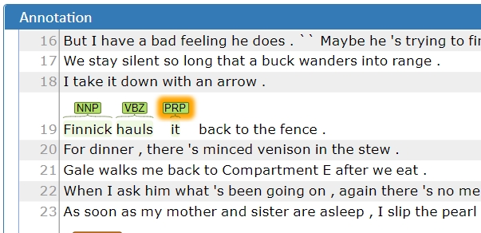
1. Tag POS (Mockingjay)
Layer: POS
Finnick → NNP
hauls → VBZ
it → PRP

Slide 50
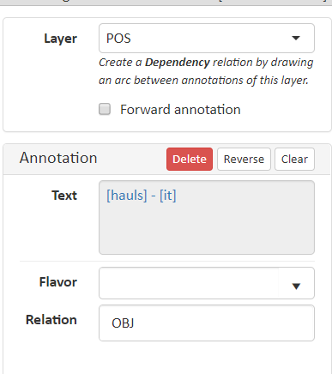
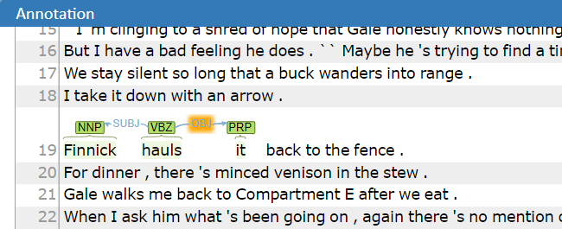
2. Tag relationships (Mockingjay)
Connect Finnick-hauls
Connect hauls-it

Slide 51
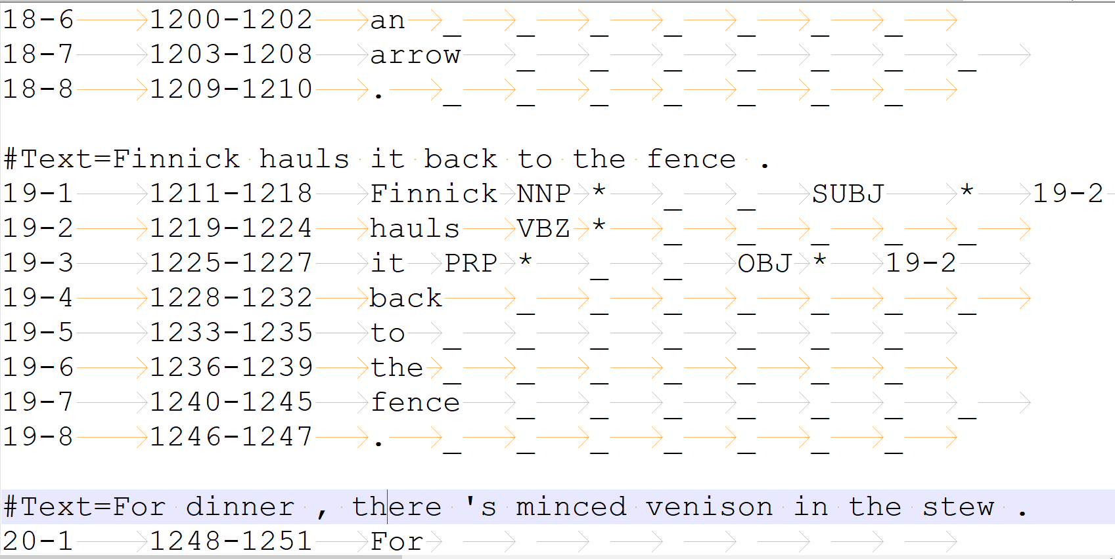
3. Export and inspect

Slide 52
Create project from scratch
What I would do to tag the Talmud

Slide 53
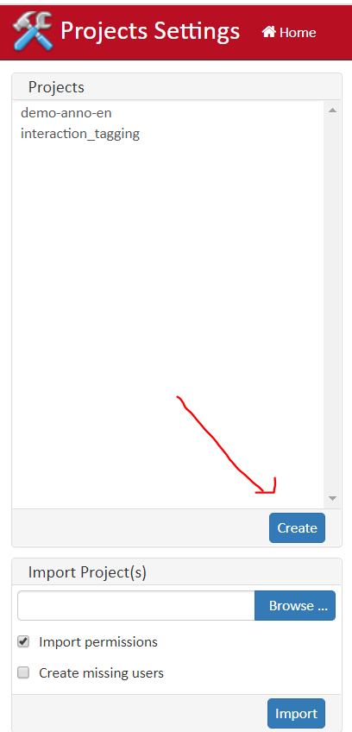
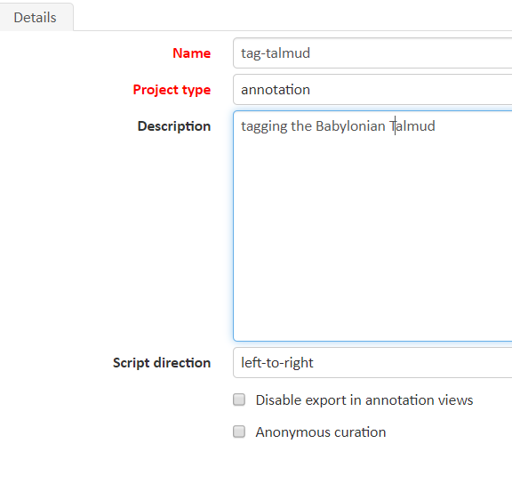
1. Create new project
Home / Projects / Create
Fill in details
Name, project type, desc
Left to right?
Save (will suddenly populate tabs)

Slide 54
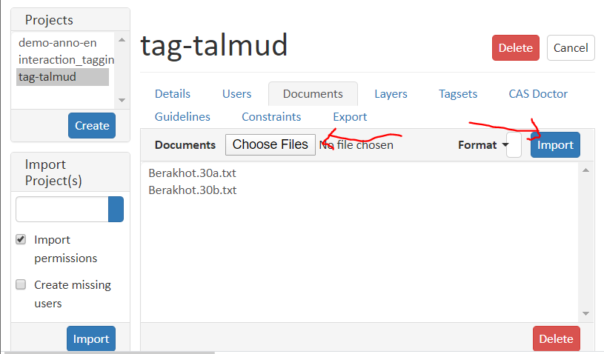
2. Add Documents
We will add:
Berakhot.30a.txt
Berakhot.30b.txt
Can add more later
Format: plain text
Select files / Import

Slide 55
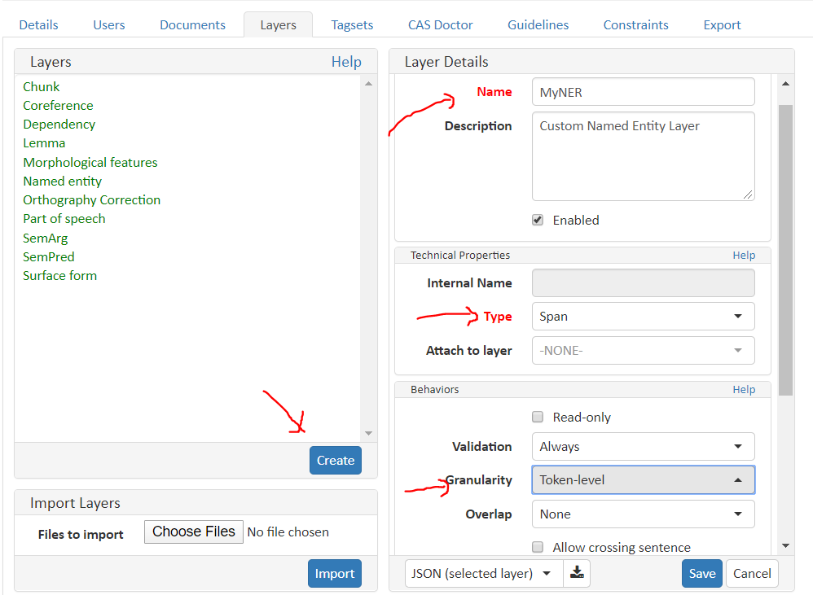
3. Create MyNamedEntity layer (instead of using existing)
Layers / Create
Discuss 3 Types
Discuss Granularity
Save

Slide 56
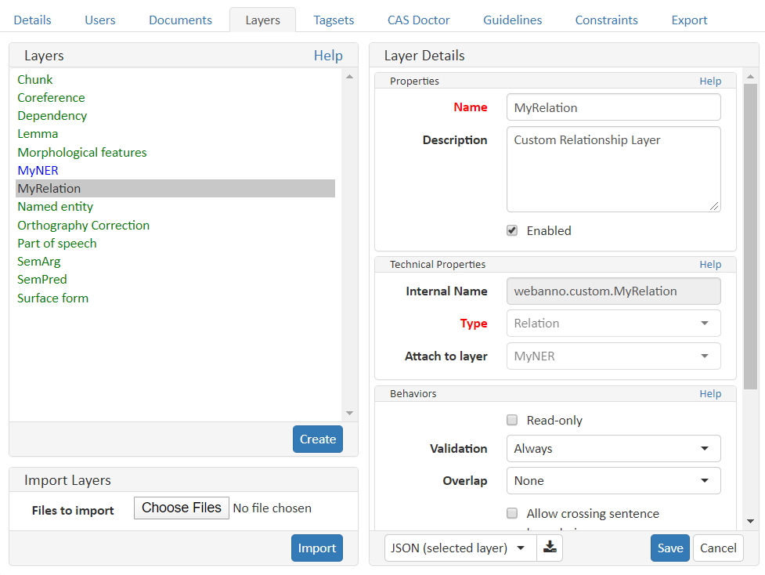
3. Create MyRelation layer
Layers / Create
Type is Relation
Attach to MyNER layer

Slide 57
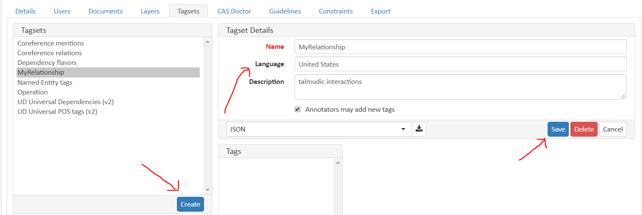
4a. Create a new Relationship tagset
For the MyNER layer, we choose to reuse NamedEntity Tagset
For MyRelationship, will create new Tagset
Create / fill in details / save

Slide 58
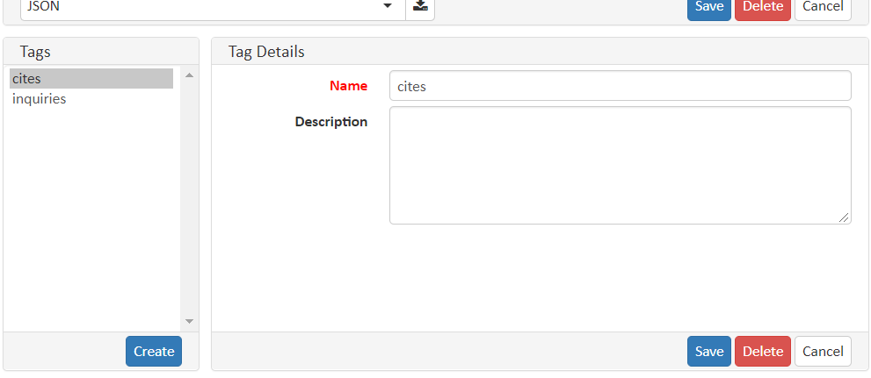
4b. Add tags to tagset
“Create” tags for cites and inquires.
Add details.
Save will add to list

Slide 59
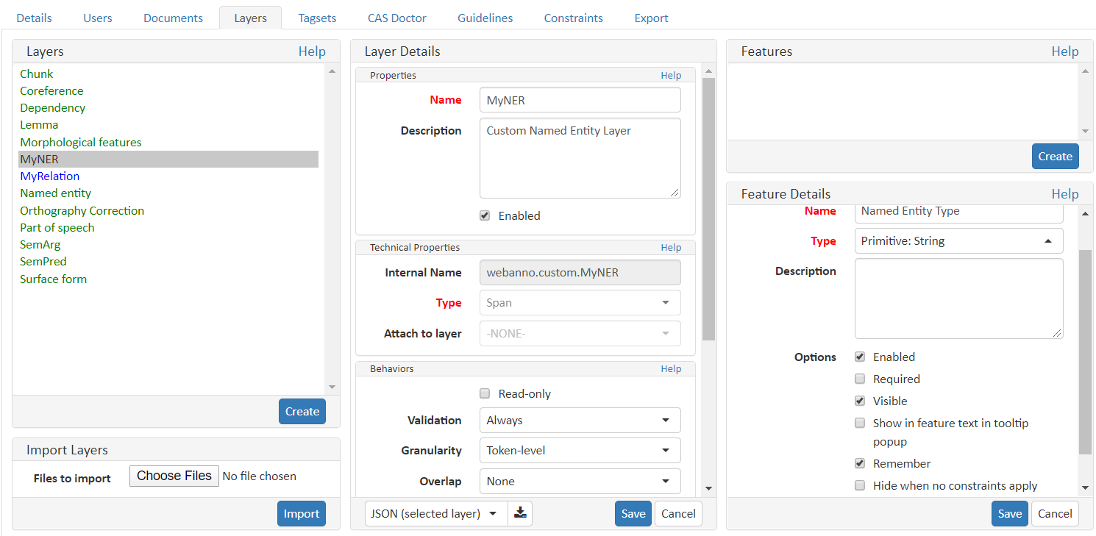
5a. Associate tagset with layer
Features: Create
Give Name, Type
Is Primitive: String
Select Remember
Scroll down
Tagset: Named Entity tags
Save

Slide 60
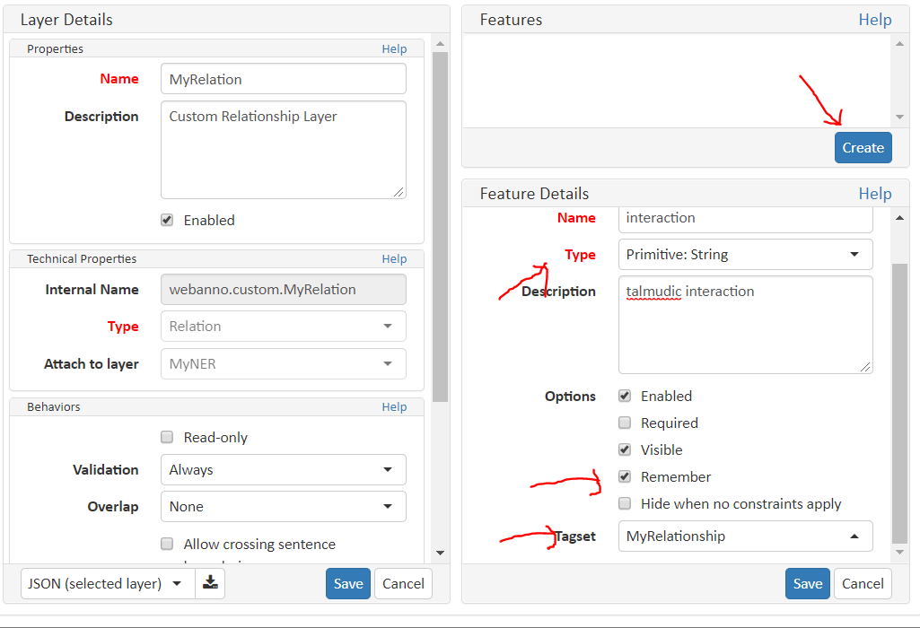
5b. Associate tagset with layer
Same as before
Since relationship layer, use MyRelationship tagset
Save

Slide 61
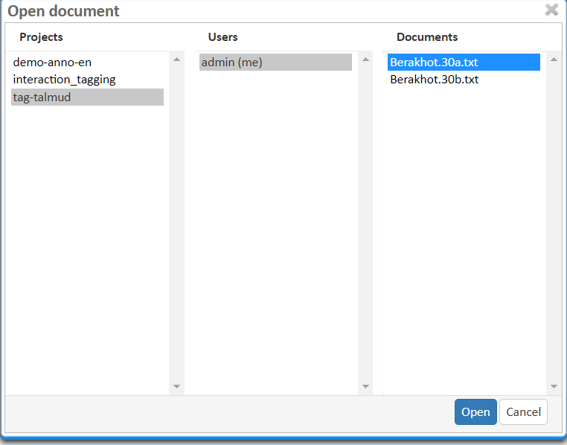
6a. Tag your Named Entities
Home / Annotation
Select first file

Slide 62
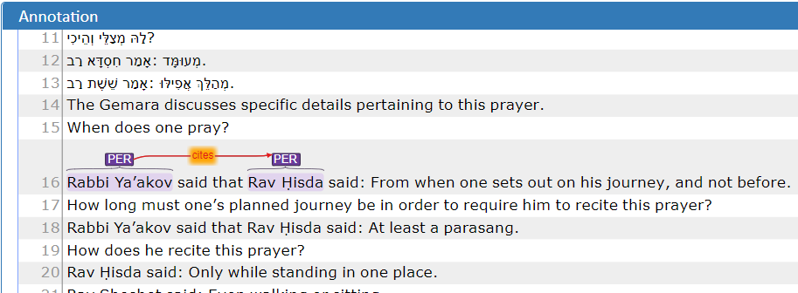
6b. Tag your Named Entities
Modify settings
LTR / RTL
40 rows
Dynamic pastelle for our two layers
Layer is MyNer
Persons are Rav Hisda and Rabbi Yaakov
Citation relationship

Slide 63
Some Python code

Slide 64
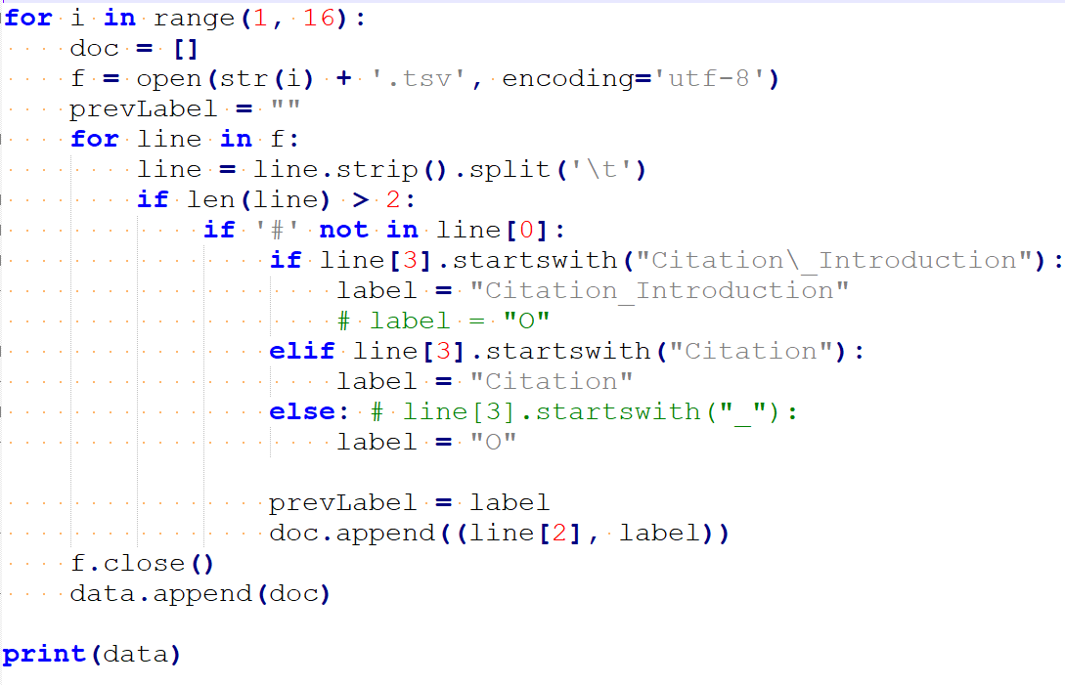
1. Reading in the tsv file, create documents

Slide 65
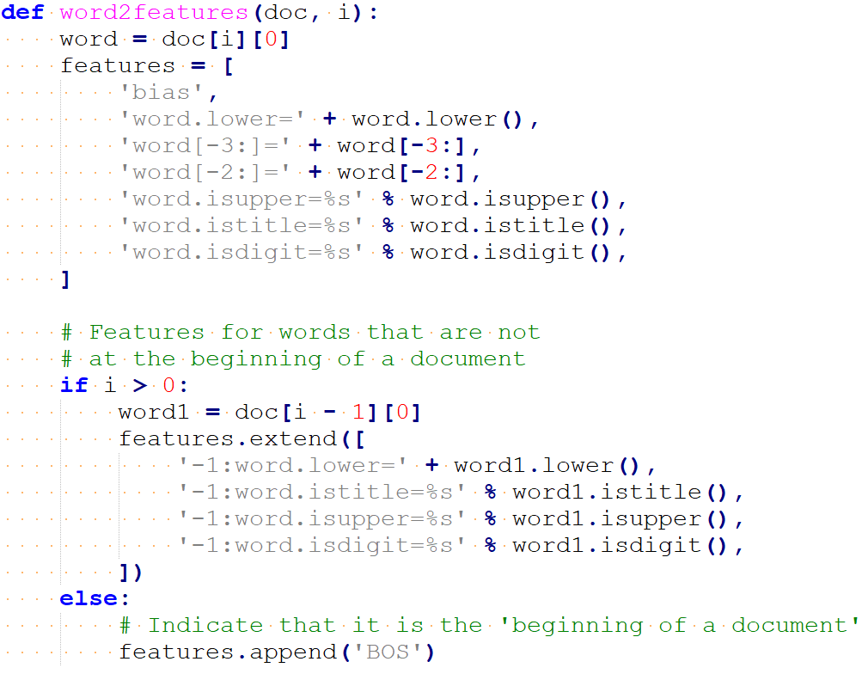
2. Defining features for CRF model

Slide 66
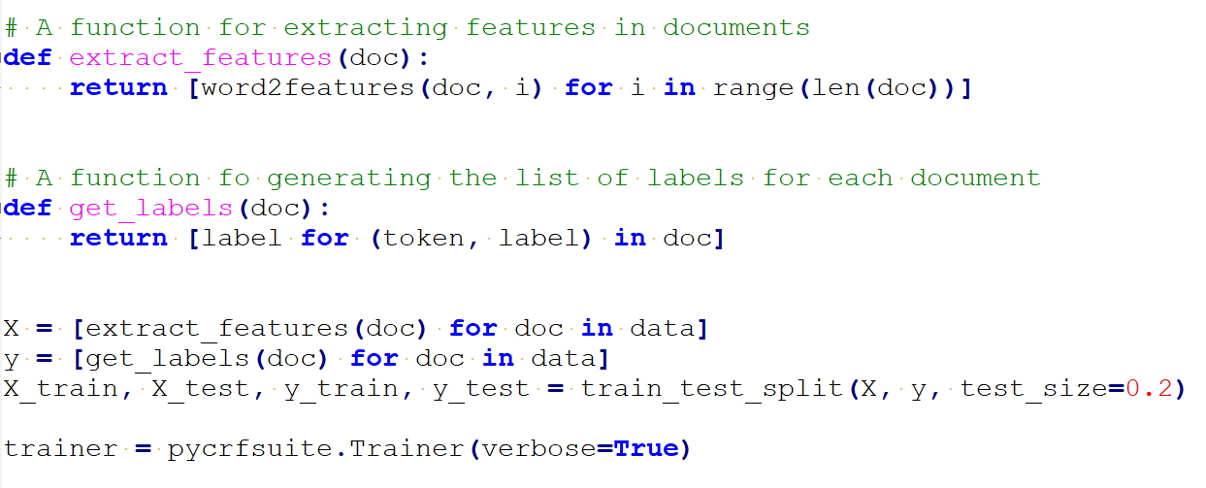
3. Using features to train model

Slide 67
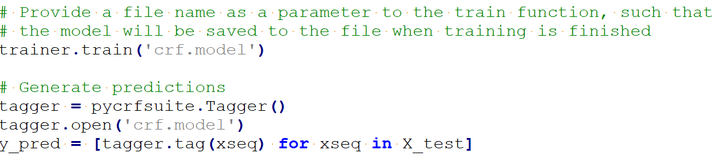
4. Tag texts using CRF model

